Slide 1

MHCARE WEBSITE FOR MENTAL HEALTH
Group Members
Akshat Bhagat
Anupama CV
Jay Desai
Divyam Singh
Lionel Rodrigues
FINAL GROUP PROJECT
IS 663 SYSTEM ANALYSIS AND DESIGN

Slide 2
Agenda for today's presentation
Part I - Feasibility Analysis/Market Research/Competitors
Part II - Project Planning and Management
Part III - Software Requirements Specification (SRS) Document
Part IV - Architecture document
Part V - Design documents
Part VI - Software Prototype
Part VII - Retrospective
Part VIII - Presentation & Demo – must be made available for review and user testing by the class and Q&A

Slide 3
INTRODUCTION
As we all know that mental health is a serious issue in today’s world.
Research suggests that approximately 10.7% of the worlds population is suffering from Mental health issues and about 46% of suicides are a result of a mental health condition or illness
Study shows 19.8% of Americans are suffering with mental health issues about half of Americans are not getting treatment for their mental health conditions.
Our website would help people get aware of their mental health status and would provide patients with the medical help needed.

Slide 4
Problem Statement and Goal:
This website would help people to get the necessary medical help required if they are going through any sort of mental health issue
This website will also offer medical help in terms of connecting with medical professionals like Doctors, Psychiatrists, and more.
To improve management information on mental healthcare in the region.
To offer a better record-keeping system for healthcare professionals involved in diagnosis and treatment.

Slide 5
Scope
For our system, we will be using a chatbot for Q&A purposes.
With the help of the system, the users would be able to recognize their own mental health status
Also, the system would help the users to seek help from the nearest possible resources such as Doctors, Psychiatrists, Pharmacists, and more
. Users would be able to book their appointments with their respective doctors and vice versa.

Slide 6
Domain Of Interest:
Access to mental health services can be widened through digital technologies. Over the past few years, there has been an increase in the number websites available to promote mental health and well-being, and there is some evidence to indicate that these websites can be used to treat depression, anxiety, and other mental health issues.
In a survey of military veterans' interest in web applications, it was shown that 43% were interested in using a mental health app. However, only 11% had accomplished. So, with worries about a lack of evidence of efficacy (72%) being a key obstacle to adoption.
The rapid growth of accessible mental health websites with minimal regulation or control reflects this lack of evidence. Due to the issue of wide access but low evidence foundation, many items that are available to the general public have little or no evidence to support their use.

Slide 7
Key Competitors:
NAME | FEATURES
TALK-SPACE | Talk-space offers therapy with a mental health professional. You can change therapists. Access to treatment and Talk-space features 24/7.
CALM | Calm is simple to use, and the exercises are easy to follow. It's a great mental health app for beginners. Features of Calm include breathing exercises, sleep programs, relaxation, and mindfulness techniques. You have access to sleep stories narrated by celebrities like Harry Styles or Laura Dern.
MHCare | MHCare provides networking with medical professionals such as Doctors, Psychiatrists, etc. Specific relaxing activities for specific mental health issues. Provides networking with other users. Provides video conferencing facility for appointments with doctors and candid conversations with other users. Payment options, gateway for services like buying prescribed medicines from pharmacists, booking appointments with medical professionals.

Slide 8
Process Model:
We have gone for Agile Methodology.
Agile project management, which divides project operations into smaller cycles known as sprints or iterations, is an iterative technique for planning and steering project processes.
Teams can publish segments as they have finished thanks to the Agile methodology.
Why we have gone with Agile, it is a continuous release method, teams can demonstrate that these portions are successful, and if not, they can instantly rectify any concerns. It is believed that the continuous improvement throughout the project lifespan decreases the chance of significant failures.

Slide 9
Our Agile methodologies are built on the ideas mentioned below
Changes can be made at any time
Agile helps teams to adopt the methodology while also assisting them in adapting to change. Agile recognizes that customer demands change over time and that teams must be adaptable. Any update or maintenance item is added to the queue and assigned to a later sprint based on priority and business requirement.
Test Minimize Risk
Agile teams testing software products receive input almost every day and may take rapid adjustments. Sprint-based product development allows teams to quickly review their progress and make appropriate improvements.
Quality Product
Our project team does not attempt to build all of the features at once. Instead, the team limits the quantity of features in each version. As a consequence, the creators will have more time to improve such items before publishing them. here we are trying to attain the highest quality

Slide 10
Product Backlog
User | Priority
As a user, I am able to login into the website. | 1
As a user, I am able to efficiently communicate with AI Chatbot. | 2
As a user, I am able to access my account and make changes. | 2
As a user, I am able to access doctors’ profiles and information and pharmacist information. | 3
As a user, I am able to book appointments. | 3
As a user, I am able to update my status. | 4
As a admin, I am able to access all the system data and files and make necessary changes. | 1
A product backlog lists and prioritizes the task-level items necessary to carry out the roadmap's strategic strategy.
The backlog should specify the tasks that the development team must complete in order to carry out the plan's general goals.
User stories, bug patches, and other tasks are commonly included in a product backlog.

Slide 11
Risk Management:
Financial, operational, and other forms of risks can be anticipated and evaluated, and strategies to minimize or lessen their impact can be identified through risk management
Analysing potential threats to a project's success through a process called "Risk Analysis" has been used successfully on countless occasions. As a result, we are better equipped to evaluate the potential consequences of a course of action and make educated decisions for the company.
RISKS/Customer | OVERALL IMPACT | LIKELIHOOD | MITIGATIONS OR CONTROLS
Changing Users requirements | Medium | Likely | Specification of initial basic requirements for each module separately and keeping it systematically documented. Follow this process for each stage of development.
System Scalability | Major | Likely | we can integrate and host the website on a cloud-based platform. E.g.: Google Cloud, AWS, and Microsoft Azure.

Slide 12
Potential threat to our business strategy
Data stroage: If important information is not stored in a secondary, easily accessible location in case the mobile device is lost, stolen, or malfunctions, the consequences could be disastrous.
System Scalability: As the website would go popular, more users and doctors would join and use the product. So, our system should be scalable and flexible to manage the workload. This is one of the risks we face.
AI Chatbot Malfunction: Since we are using the AI ChatBot feature on our website, there is high chance that the model malfunctions. This is also one of the risks we face in our project
Widespread discrimination and prejudice: it has been seen that using digital tools for mental health can increase the risk of stigmatization for young adults and children, especially when relevant data is made public. The acts of stigma on young people's lives can be devastating. The disclosure of personal information can make cyberbullying even more distressing, but it occurs frequently.

Slide 13
System Overview
Most mental health patients do not require dedicated hospital treatment but need to attend specialist clinics regularly where they can meet a doctor who has detailed knowledge of their problems
Since the nature of mental health disorders, individuals are frequently disorganized and may miss appointments, intentionally or unintentionally misplace prescriptions and medicines, forget instructions, and make excessive demands on medical staff.
Key Features of the System
Individual Care Management
Management Involuntary Detention
Administrative Reporting
Patient Monitoring

Slide 14
SYSTEM USER
ADMIN
PHARMACIST
PATIENT
DOCTOR

Slide 15
FUNCTIONAL REQUIREMENTS (examples 1)
SR. NO | MODULE NAME | APPLICABLE ROLE | DESCRIPTION
1 | LOGIN | PATIENT DOCTOR ADMIN PHARMACIST | PATIENT: Using the patient's profile, the patient can login using a user Id and password. DOCTOR: Login with a user Id and password from the doctor's profile. ADMIN: Using the admin's profile, you may login using a user Id and password. PHARMACIST: Using the pharmacist profile, you can log in with user id and password

Slide 16
FUNCTIONAL REQUIREMENTS (examples 2)
SR. NO | MODULE NAME | APPLICABLE ROLE | DESCRIPTION
2 | DOCTOR MODULE | ADMIN DOCTOR | ADMIN-Can add or remove doctors / therapists by providing all the required information. DOCTOR – Can update the patient history in the module

Slide 17
FUNCTIONAL REQUIREMENTS (examples 3)
SR. NO | MODULE NAME | APPLICABLE ROLE | DESCRIPTION
3 | PHARMACY | PHARMACIST | Pharmacist will be able to access basic details of the patient and provide the given medication

Slide 18
Security and Privacy requirements
Privacy Requirements
Privacy regulations are intended to guarantee that clinical ethical standards are upheld, and that the authority abides by the laws of the Data Protection Act.
The system must guarantee that only authorized clinical and management personnel have access to personal information on patient records.
2. Security Requirements
Access to the functionality of the MHCare system shall be controlled according to the role of the information user.
The MHCare system must feature a role-based access control system that permits access to information to be set depending on the system user's role.

Slide 19
Non-Functional Requirements
1. Availability
Availability describes how likely the system is accessible to a user at a given point in time. Our service will be provided to the user 24/7 to all our patients.
2. Usability: The website should be easy to navigate and use, with a user-friendly interface.
3. Accessibility: The website should be accessible to users with disabilities, including those with visual, auditory, or motor impairments.
4. Security: The website should be secure, with measures in place to protect user data and prevent unauthorized access.
5. Performance: The website should load quickly and be able to handle a large number of users without experiencing delays or errors.
6. Scalability: The website should be able to handle an increase in traffic or users without experiencing performance issues.

Slide 20
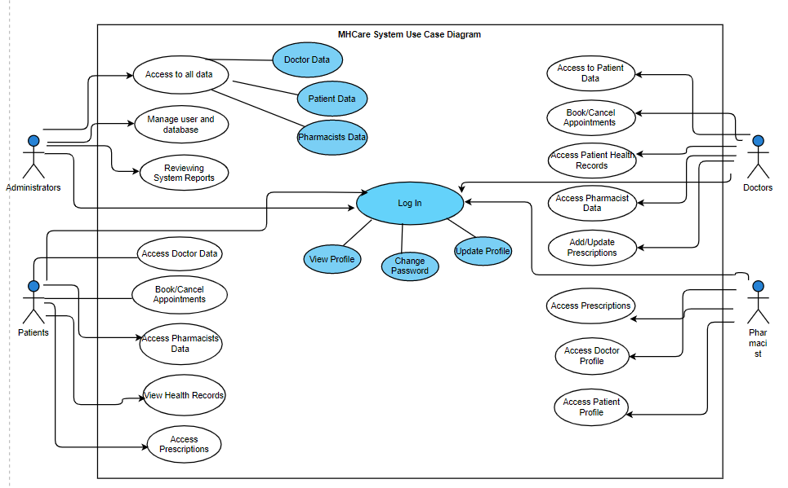
System Use Case :

Slide 21
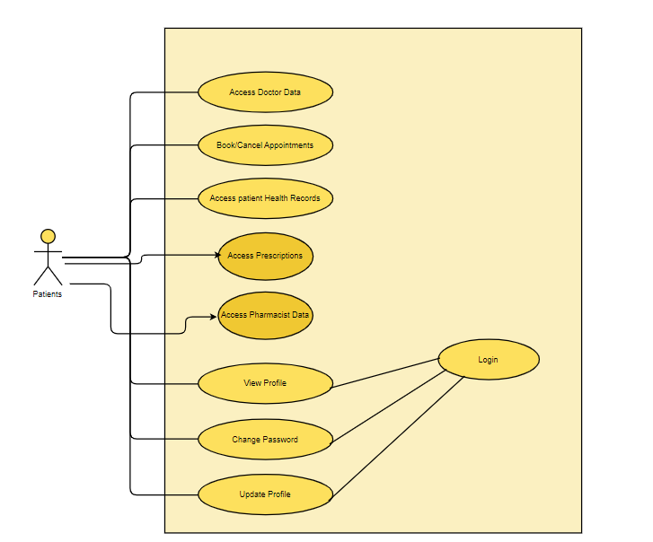
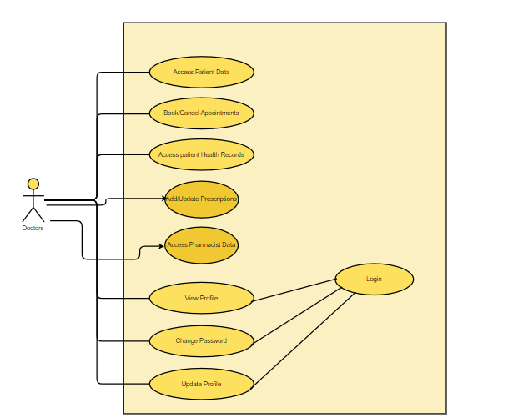
Use case examples (Patients and Doctors)
Patient
Doctor

Slide 22
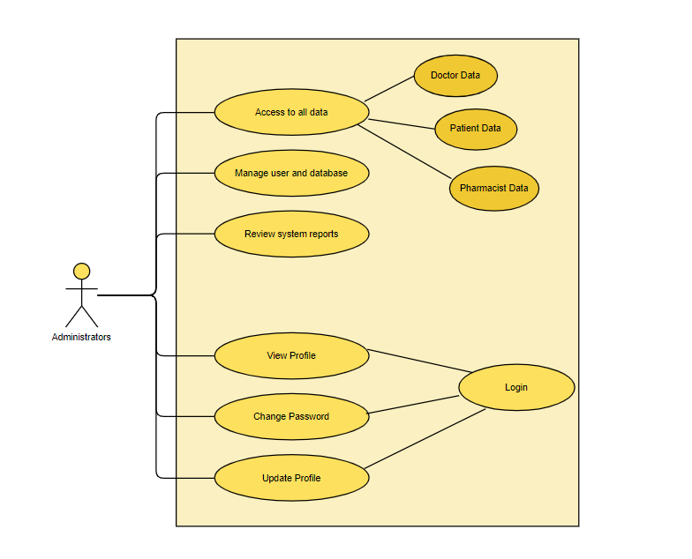
Use case examples 3 (System Admin)

Slide 23
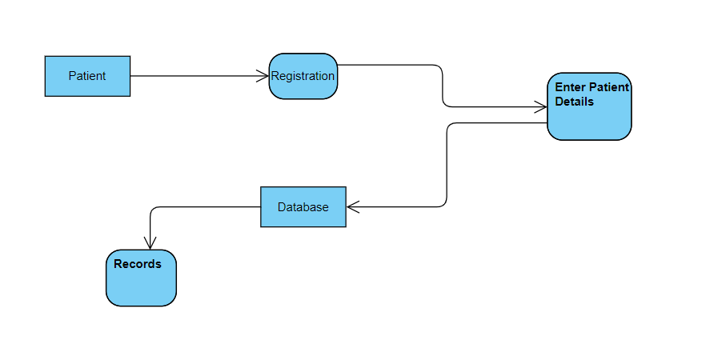
Activity Diagrams for our system: example1 Registration Module:

Slide 24
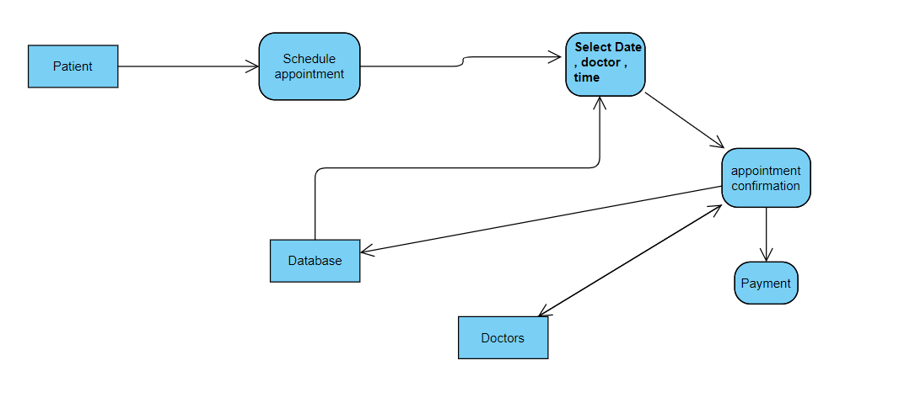
Activity Diagrams for our system: example 2 Appointment module

Slide 25
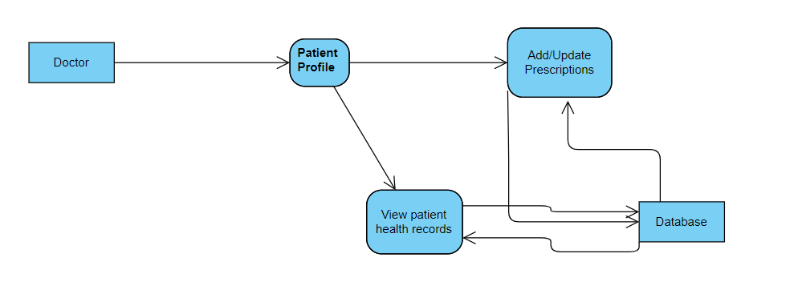
Activity Diagrams for our system example3: Doctor module

Slide 26
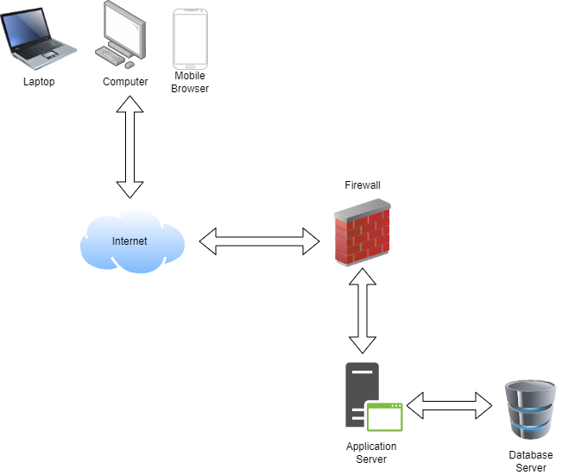
Architecture document
The significant inputs from the database server to the user interface are illustrated in the reference structure. Our application is accessible on PCs, laptops, and mobile browsers. The user can then access the information by using mobile data or an internet connection to aspects of the application. To prevent unauthorized access, the firewall is deployed for privacy considerations. All the data of the patient, doctor, pharmacists, and other important attributes such as the medical records, and medications are stored data storage.

Slide 27
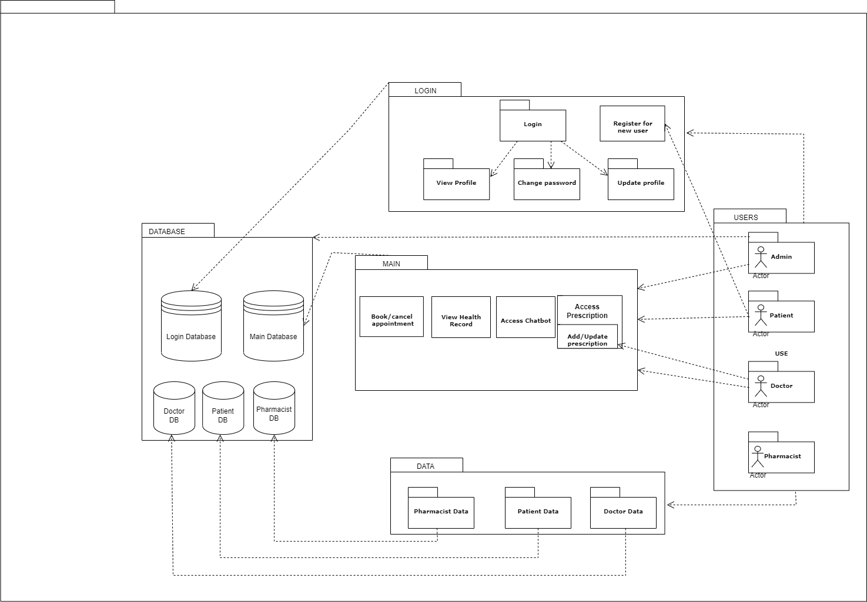
Software architecture
The System includes login and register page where the patients can view as well as update their profile, while the new users can register themselves.
Through the main menu the patients can book or cancel appointments, view their health records as well access the chatbot and prescriptions added by the doctors. The pharmacist, patient and doctor data are stored in the local database which is accessible to the admin, patient, doctor, and the pharmacist.

Slide 28
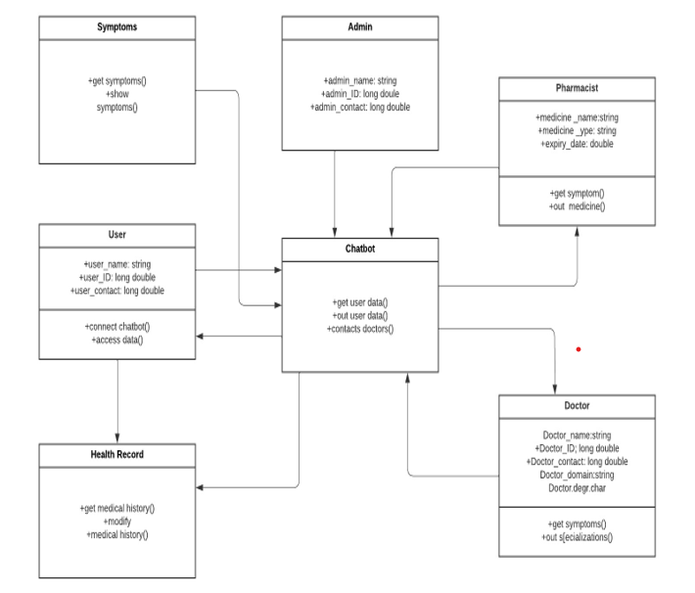
Class Diagram

Slide 29
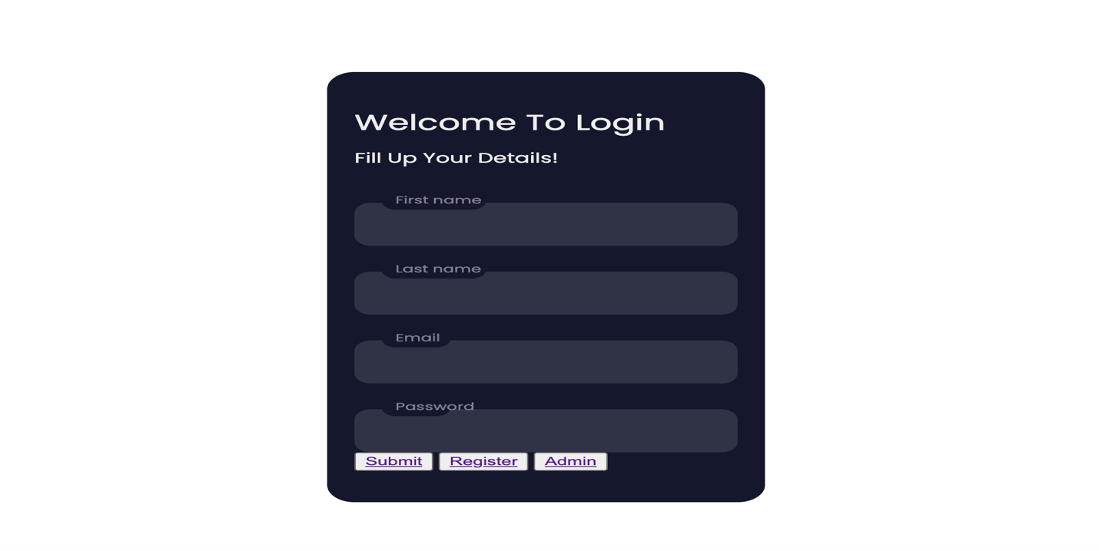
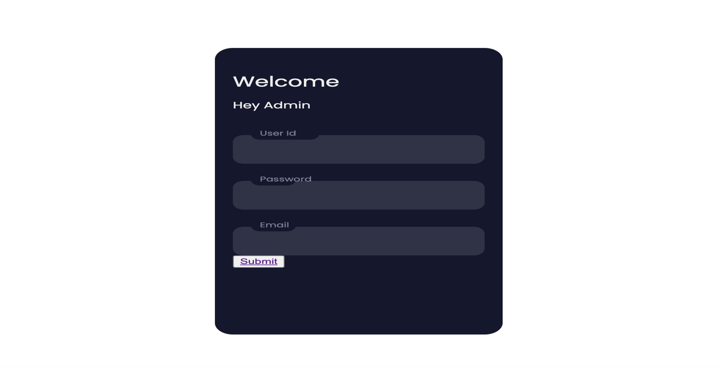
User interface Diagram
Login page
Admin login

Slide 30
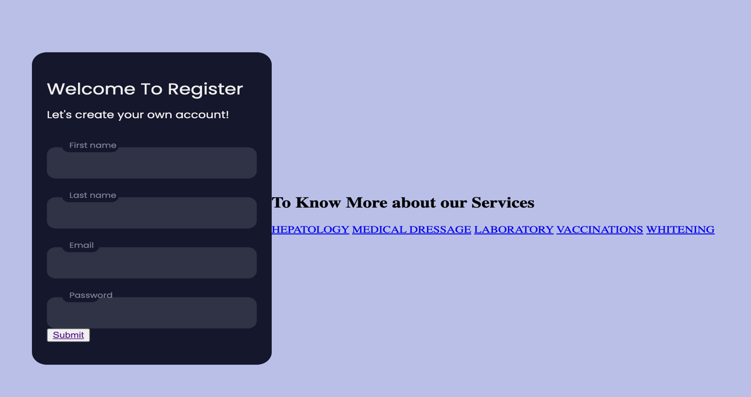
Register Page:

Slide 31
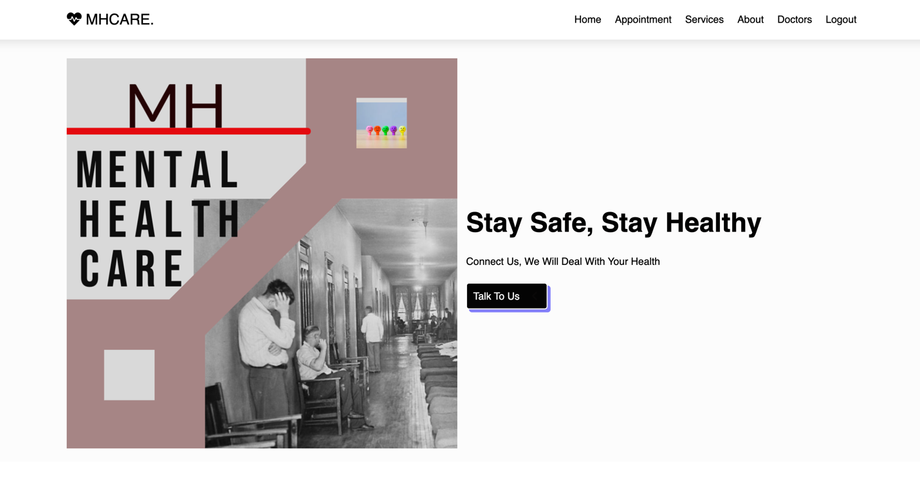
Services

Slide 32
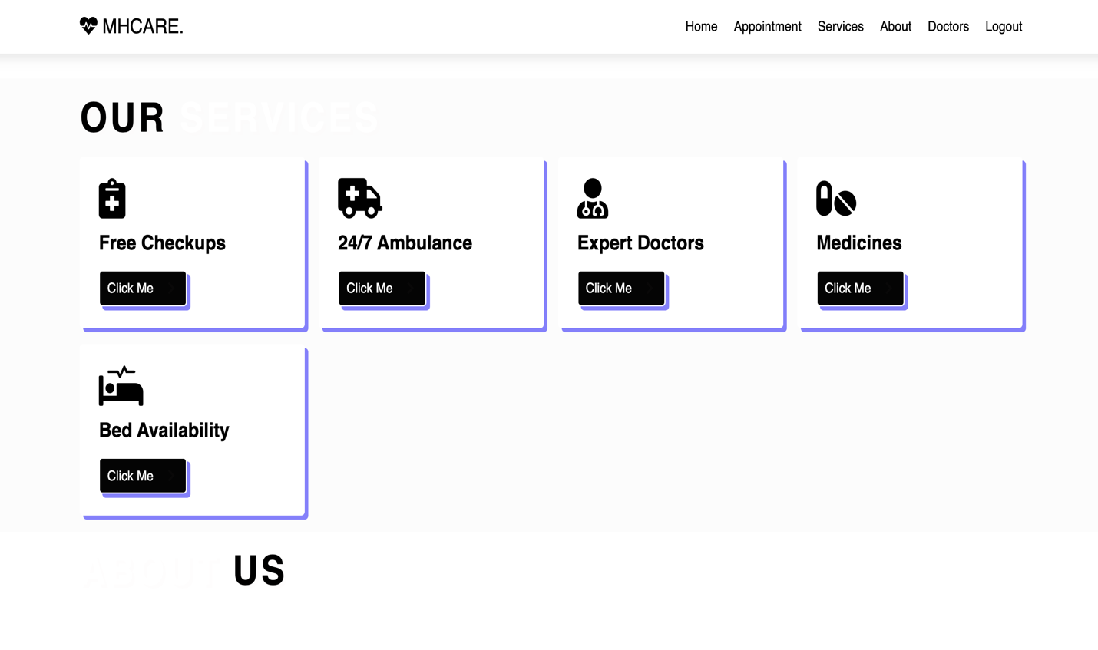
Services

Slide 33
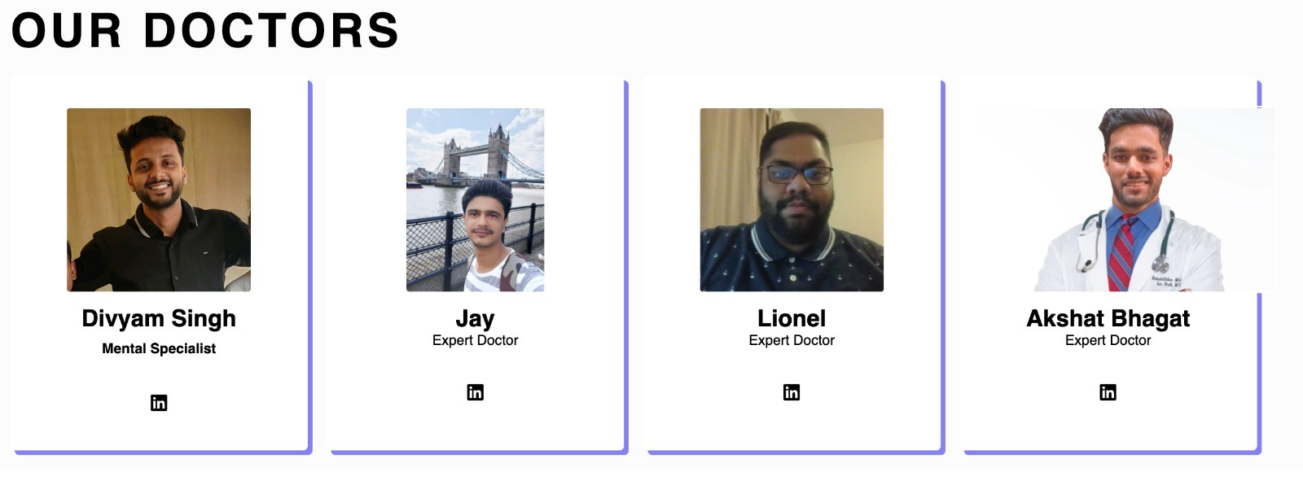
Doctors :

Slide 34
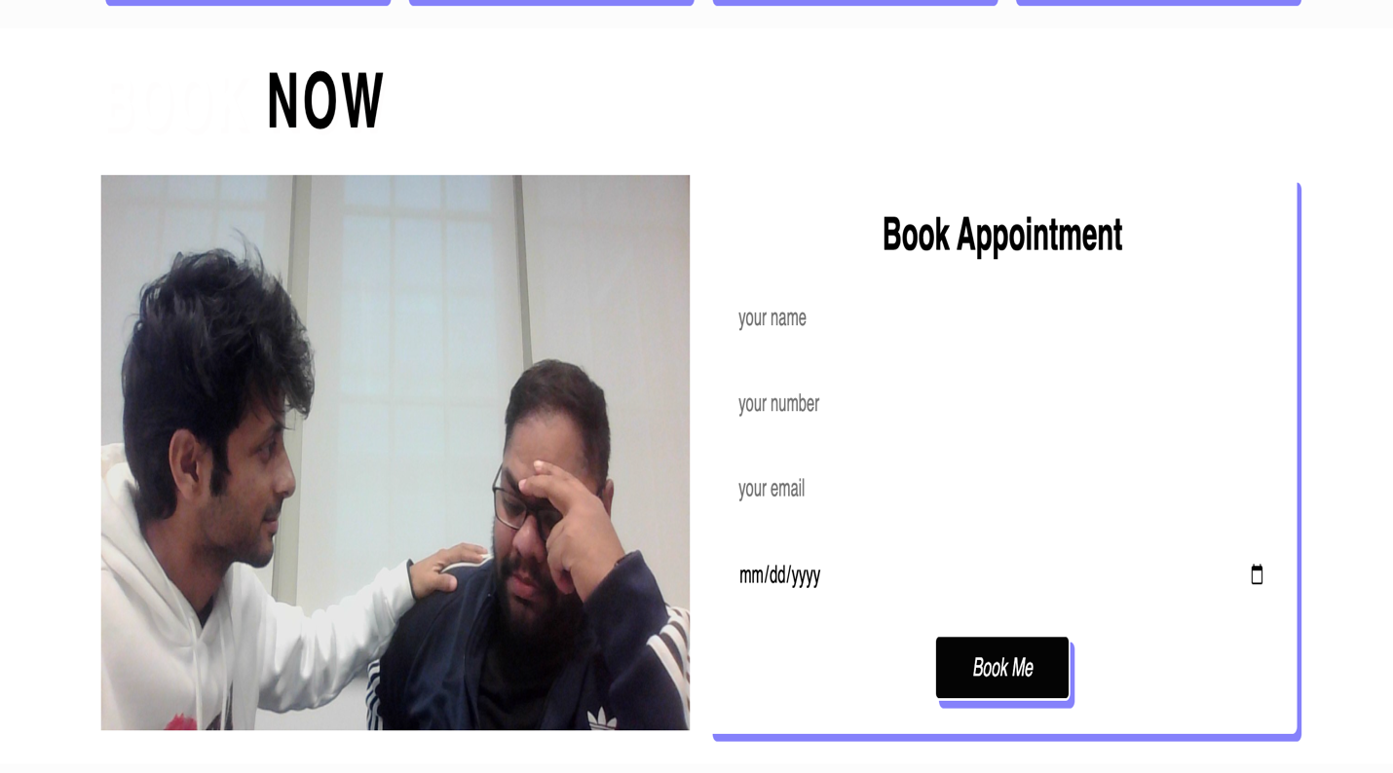
Appointment booking

Slide 35
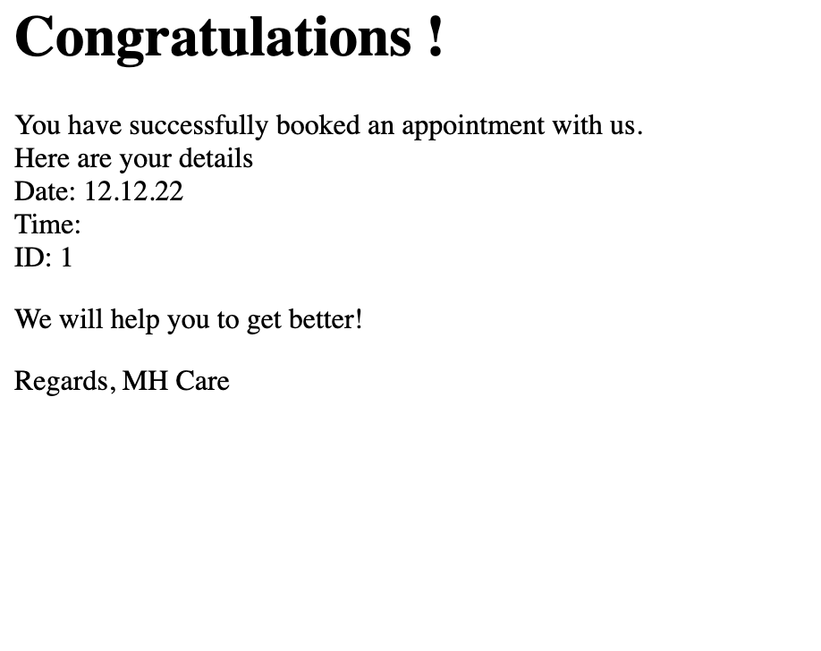
Booked appointment

Slide 36
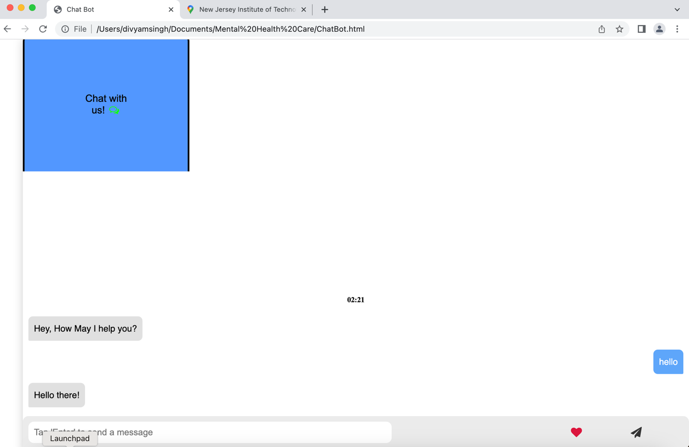
Our best Feature

Slide 37
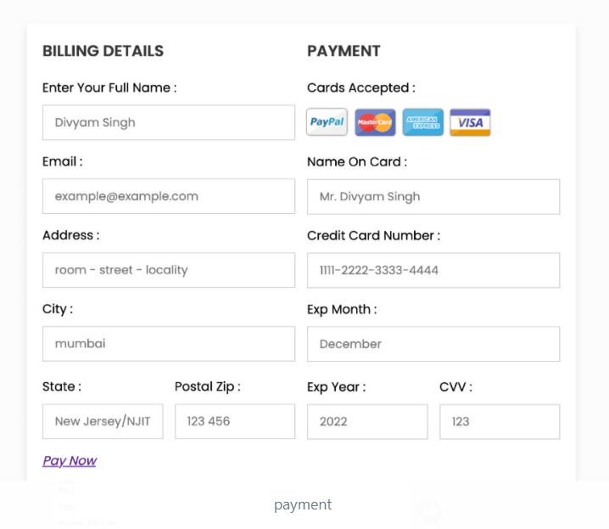
Payment

Slide 38
Conclusion:
So, to sum up, our product idea, we plan to make an AI-driven Website that helps people's mental health
Those struggling with mental health disorders may find it difficult to receive professional help due to factors such as the high cost of treatment and negative stigma in the community
To those in need of mental health guidance and professional assistance, we hope to aid in the establishment of a welcoming community
The conversation with our chatbot would be warm and friendly; it would encourage the user to share their feelings and express themselves just as they might with a trusted friend or partner.

